Slide 1
Transmission Lines
Will Watkins & Daniel Rostotsev

Slide 2
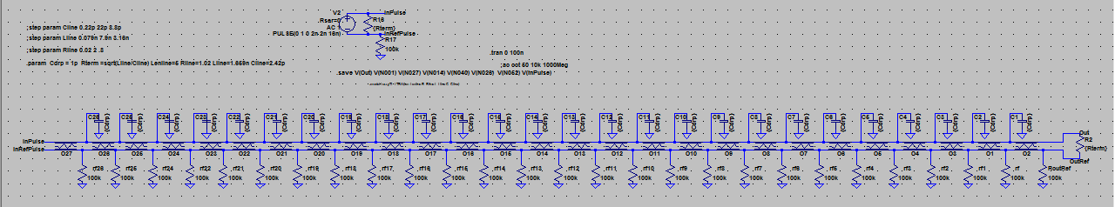
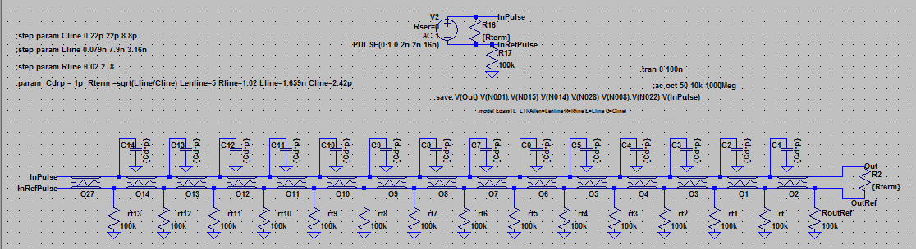
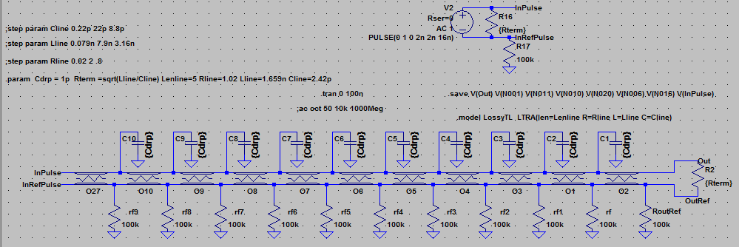
Transmission Line with 28, 14, or 10 Drop-offs
Capacitive drop-offs for signal devices
Input is a square pulse with finite rise and fall times, 2ns each

Slide 3
LTSpice
Inputs a netlist file, which can use variables to control various parameters
.step param command can be used to increment parameters to see how the circuits behavior changes with different resistances, inductances, etc.
Limited to only three .step param directives
We needed to increment Rline, Lline, Clin, Cdrp and Lenline

Slide 4
Auto_LTSpice
Automate the LTSpice process using C programming
Open the netlist file and update the parameters to mimic the .step param spice directive
Then rerun LTSpice with system() call
Output RAW files are named based on the stepped parameters
Examples:
tran_Rline=1.0_Lline=2.4n_Cline=6.8p_Cdrp=1.0p_Lenline=1.0.raw
ac_Rline=1.0_Lline=2.4n_Cline=6.8p_Cdrp=1.0p_Lenline=1.0.raw
Tran/ac denotes a transient analysis and small-signal ac analysis respectively

Slide 5
Auto_LTSputil
RAW files are not ASCII-encoded, so ltsputil is used to convert output from LTSpice into a readable format
From netlist, generates what the RAW file names would be and finds those files and input them into ltsputil and creates CSV files and puts them into folders categorized by the Cdrp and Lenline parameters
Each folder then contains 1000 files describing all combinations of the parameters for the transmission line’s RLC

Slide 6
Auto_LTSpice_Now

Slide 7
Final Run – Executables
Folder Hierarchy
To create simulation files for the specified netlist with more than three parameters that will be stepped, first make sure ALL .step param directives are commented out, as Auto_LTSpice will step all parameters itself
Then from a bash shell, execute “./Auto_LTSpice.exe FILENAME”
FILENAME must include pathway if files aren’t in the same directory
This will generate all the RAW files and they’ll be placed in the directory where Auto_LTSpice.exe is
Then, still from bash shell, run “./Auto_LTSputil.exe FILENAME”
This will create a folder hierarchy in the current directory
MultidropBode
MultidropTransient
Lenline_X_Cdrp_X_VnXXX
Lenline_X_Cdrp_X_VnXXX
AC Analysis CSV Files named by RLC values
Transient Analysis CSV Files named by RLC values

Slide 8
Final Run – Python Scripts

